Slide 1
Foundations of Group Behavior 2

Slide 2
Group Properties
Group properties:
Shape & explain
Individual behavior within the group
Performance of the group

Slide 3
Group Properties
Role
Norms
Status
Size
Cohesiveness
Diversity

Slide 4
Roles
A set of expected behavior patterns attributed to someone occupying a given position in a social unit

Slide 5
Role
Role perception:
An individual’s view of how he or she is supposed to act in a given situation
Role expectation:
The way others believe a person should act in a given situation

Slide 6
Role
Psychological Contract:
An unwritten agreement about what management expects from an employee and vice versa
Violation → negative impacts (high turnover, low productivity, etc.)

Slide 7
Role
Role Conflict:
A situation in which an individual is confronted by divergent role expectations

Slide 8
Norms
Acceptable standards of behavior within a group that are shared by the group’s members
A set of “dos” and “don’ts”
Performance norm
Appearance norm (dress code)
Social arrangement norm
Resource allocation norm
Violation → ostracism

Slide 9
Norms
Conformity
The adjustment of one’s behavior to align with the norms of the group
Conformity pressure

Slide 10
Status
A socially defined position or rank given to groups or group members
Status characteristics theory
Control resources and results
Ability
Personal Characteristics

Slide 11
Status
Norms
Group interaction
Inequity

Slide 12
Size
Social loafing
The tendency for individuals to expend less effort when working collectively than when working individually
More members
Higher total productivity
Lower individual productivity
Why?

Slide 13
Size
Social loafing
Ways to prevent

Slide 14
Cohesiveness
The degree to which group members are attracted to each other and are motivated to stay in the group
→ group productivity

Slide 15
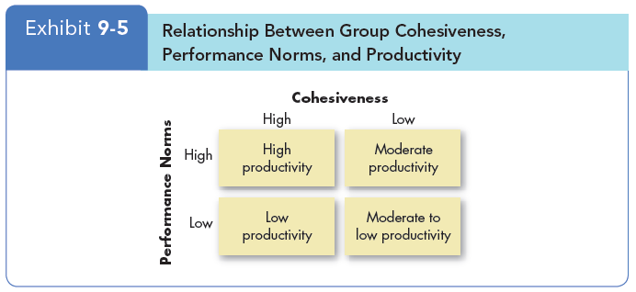
Cohesiveness

Slide 16
Cohesiveness
Ways to encourage

Slide 17
Diversity
The extent to which members of a group are similar to or different from, one another
Impact of Diversity

